Slide 1
FINDING MISSING PERSON USING AI Using Deep Learning Team-10 Smart Bridge-Remote Summer Internship Program
Developed by: RISHABH RAJ
MANOJ KUMAR B T
MANOHAR R
KARTHIK T T

Slide 2
TABLE OF CONTENTS
Introduction
Purpose
Block Diagram
Flow Chart
System Architecture
Software Designing
Experimental Investigation
Advantages
Disadvantages
Applications
Conclusion

Slide 3
INTRODUCTION
A deeply disturbing fact about India’s missing children is that, while on an average 174 children go missing every day, half of them remain untraceable. The National Crime Records Bureau (NCRB) report which was cited by the Ministry of Home Affairs (MHA) in the Parliament (LS Q no. 3928, 20–03–2018), more than one lakh children (1,11,569 in actual numbers) were reported to have gone missing till 2016, and 55,625 of them remained untraceable till the end of the year. The statistics are however, indicative of the absence of a national Missing Children’s repository. “There are no budgets earmarked for tracking missing people,” said an official source.
Missing person identification and tracking can be done using intelligent video surveillance systems. Due to some reason, the people leave the home or some child or old men forget the route of their home. To this missing case, entry is updated in police station. By using CCTV camera technology, compare each person with the available database and find these people.

Slide 4
PURPOSE
Our aim from the project is to make use of NumPy, Pandas, Matplotlib, TensorFlow, & Keras libraries from python to extract the libraries for deep learning for the face detection and recognition.
Secondly, to compare the person in the CCTV with the image of the missing person stored in the database.
And in the end, if the missing person is detected, to send a message to the police station containing the location of that person.

Slide 5
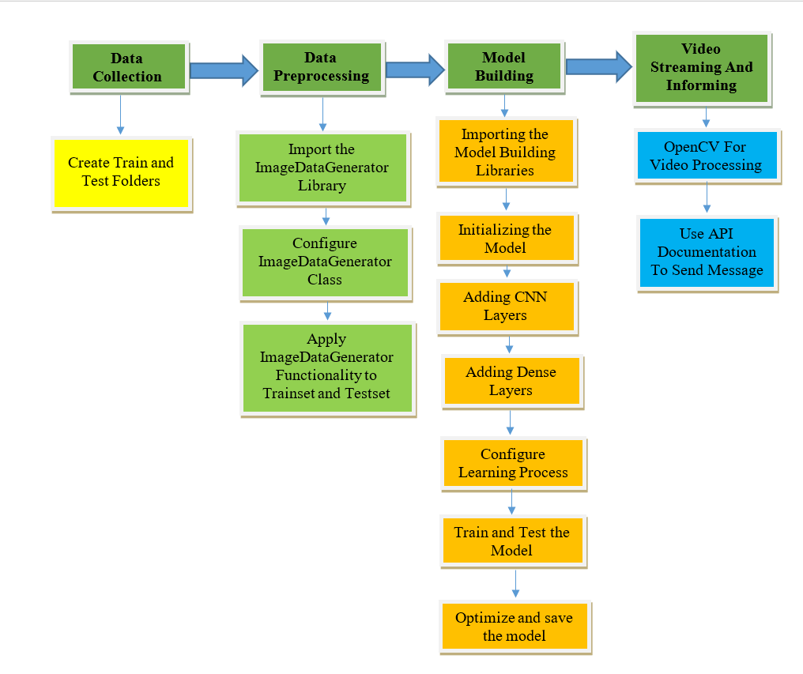
BLOCK DIAGRAM

Slide 6
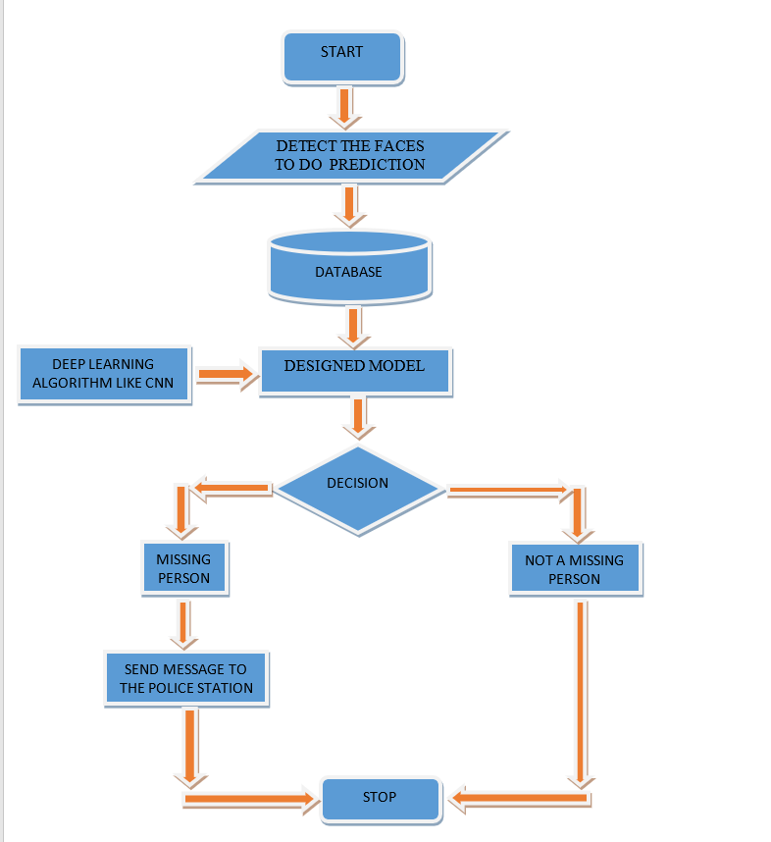
FLOW CHART

Slide 7
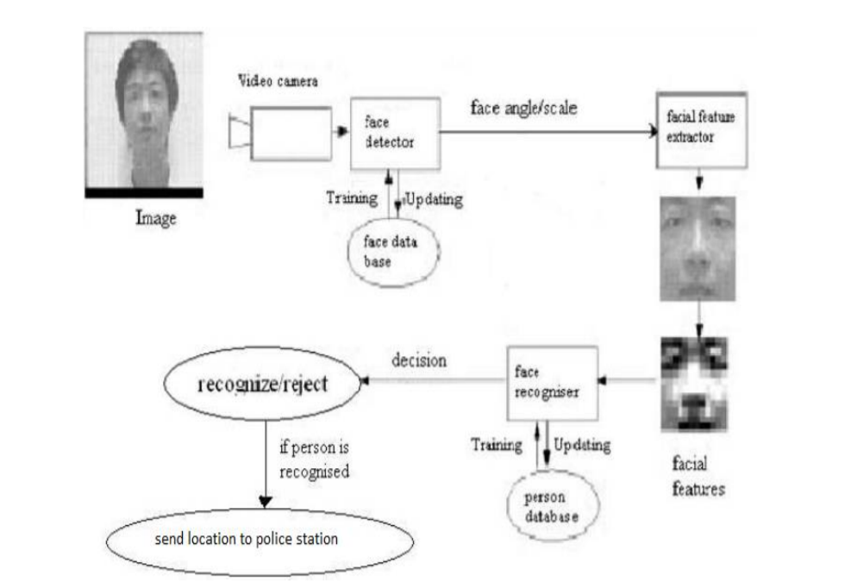
SYSTEM ARCHITECTURE

Slide 8
SOFTWARE DESIGNING
Jupyter Notebook Environment
Spyder IDE
Deep Learning Algorithms
Python (Sequential,Dense,Conv2D,MaxPool2D,Flatten)
OpenCV
We developed this “Finding Missing Person project” by using the Python language which is a interpreted and high level programming language and using the Deep Learning algorithms(CNN). For coding we used the Jupyter Notebook environment of the Anaconda distributions and the Spyder, it is an integrated scientific programming in the python language. API Documentation is used to send the message along with name and location of the missing person to the police station, whenever he is shown up in the CCTV.

Slide 9
EXPERIMENTAL INVESTIGATION
In our project, we have used our own images(faces) as Dataset. This dataset contains two folders: test set and training set. In test set folder, we have 2 or more categories. Each category has the images of a particular person and the each category is named after the names of the face of person it contains. Similarly, in the training set folder. Having 160 images belonging to 2 classes in training set and 40 images belonging to 2 classes in test set(for 2 categories).

Slide 10
ADVANTAGES
We are able to detect faces of missing person through a CCTV, so that it would be of great help to the police team to track that person.
It could bring a whole new dimension in security by tracking faces from CCTV in real-time.
Missing person face detection is easy to implement and understand.
It operates in real-time due to low time complexity.
It is applicable in training and test-time.
Deliver invariance with respect to the lesion position, scale, and rotation.
Additionally, it can be also used to track the criminals using CCTV in real-time.

Slide 11
DISADVANTAGES
With all the noise(presence of multiple faces) in the CCTV input video, still it is difficult to detect and identify an face of a missing person.
It is still a challenging task, since face images may be affected by changes in the scene, such as pose variation, face expression, or illumination.
There will be a need of good amount of face images of the missing person while training the model.

Slide 12
APPLICATIONS
“Finding missing person using Convolutional Neural Networks” simplifies the management process of tracking down a missing person manually by police.
Surveillance applications.
Works in Real- Time.
Security and authentication applications.
Fast processing and immediate results with high security.
Minimizing human effort and cost efficient databases.

Slide 13
CONCLUSION
Identification of a person in surveillance area using face information has many applications in real life. The face recognition in the images got from surveillance camera is challenging task due to the presence of multiple faces in the given area. In this paper a method has been proposed where the algorithm has been modified for the detection of the faces, extraction of the feature information and matching the features. The work can further be extended for improving the recognition accuracy as well as time for large face databases. This system is designed to find the missing people. If the missing person found in the CCTV Video streaming, then track the location of missing person. After missing person found in the CCTV Video streaming, then send location SMS to relatives of missing person and Police station. So our system can perform the very important role in security and authentication issues.

Slide 14
THANK YOU !

